Slide 1
Bioinformatics group meeting
Jianying Li
Dec. 3rd, 2014

Slide 2
Effort in selected projects
NGS in a mitochondria project
A mechanistic strategy to inform combination toxicity
Circos on a VirtualMachine

Slide 3
Effort in selected projects
NGS in a mitochondria project
A mechanistic strategy to inform combination toxicity
Circos on a VirtualMachine

Slide 4
Outline of the mitochondria project
Research rationale
Understanding the data and quality assessment
SMRT portal and SMRT analysis
Analyzing the Illumina data
Custom tailored strategies
Searching for deletion
Searching for “direct repeats”

Slide 5
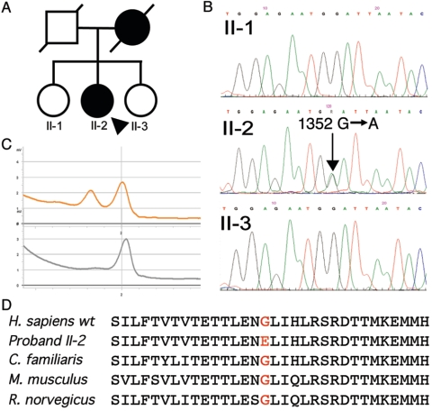
Research rationale
DNA polymerase γ (pol γ) maintain the
genetic integrity of mitochondria
A novel mutation in POLG2 (encoding
the p55 accessory subunit)
Glycine to glutamate at codon 451
Mutant was named (G451E)
Failed to encode p55 accessory subunit
of pol γ
Resulting mitochondrial disease, involving
mutation, deletion, and depletion of mtDNA
Longley, M.J et al. 2006, Mutant POLG2 disrupts DNA polymerase γ subunits and causes progressive external ophthalmoplegia, AJHG

Slide 6
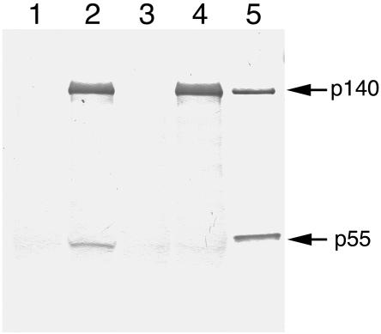
Research rationale (II)
Samples contained WT p55 alone (lane 1)
p140 catalytic subunit and WT p55 (lane 2)
G451E mutant p55 (lane 3)
p140 and G451E mutant p55 (lane 4)
0.2 μg each of p140 and p55 loaded directly
as positive controls for the western blot (lane 5)
DNA polymerase γ (pol γ) maintain the
genetic integrity of mitochondria
Measure mitochondria behavior
Longley, M.J et al. 2006, Mutant POLG2 disrupts DNA polymerase γ subunits and causes progressive external ophthalmoplegia, AJHG
Notes:
Cause progressive external ophthalmoplegia

Slide 7
Four cell lines in the experiment
With HEK293, human embryonic kidney cell line
_9: repeatedly passaged in tissue culture flasks for 9 months,
All cell line (except _0), grown in galactose medium to obligate mitochondrial function
HEK_0: untransfected cells at time point zero.
HEK_9: untransfected grown for 9 months
WT_9: cells overexpressing wild-type NGFP-p55
G451E_9: overexpressing the G451E NGFP-p55 disease variant

Slide 8
Experimental layout
With four cell lines transfected with different genes
Extracted mitochondial DNA, and a fragment (of 16486 kb) was amplified with long range PCR
PacBio RS sequencing
One lane per sample
MiSeq Illumina sequencing
PE 300 bp
One lane per sample
Main goals
Examine the mitochondrion
SNV or short indel
Large deletions

Slide 9
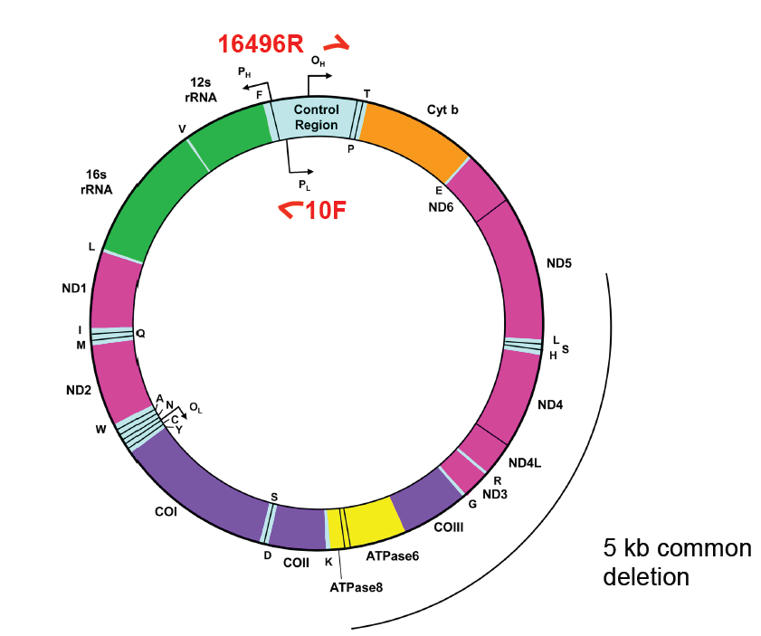
PCR primers
mt10F (nucleotide positions 10 to 40)
mt16496R (nucleotide positions 16496 to 16465)

Slide 10
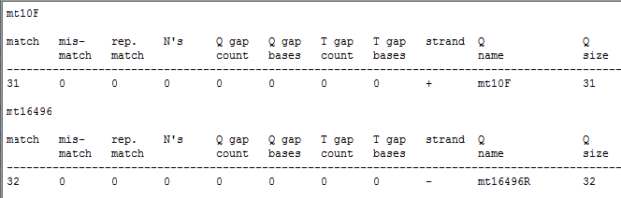
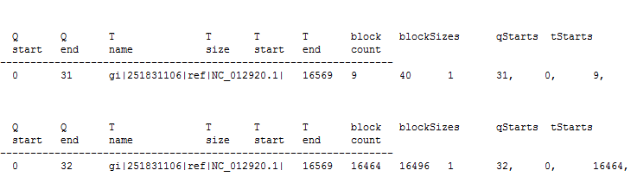
Locating the primer pairs

Slide 11
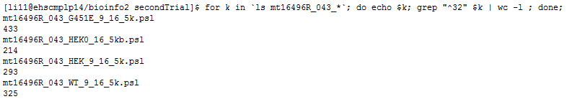
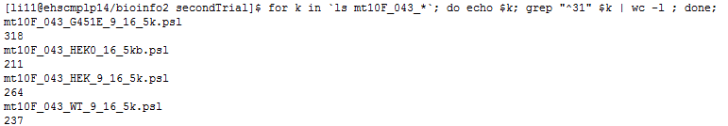
Searching for primers
1229
756
940
975
Perfect matches found
907
672
783
658
Perfect matches found

Slide 12
Read coverage -- PacBio
Sample | NumOfRead | Total n.t. | N.T. covered | Mean coverage
043_G451E_9_16_5k | 127,111 | 130,688,305 | 16,565 | 7889.42
043_HEK0_16_5kb | 107,287 | 131,160,886 | 16,567 | 7917
043_HEK_9_16_5k | 103,834 | 123,396,651 | 16,562 | 7450.59
043_WT_9_16_5k | 99,346 | 128,560,597 | 16,557 | 7764.73

Slide 13
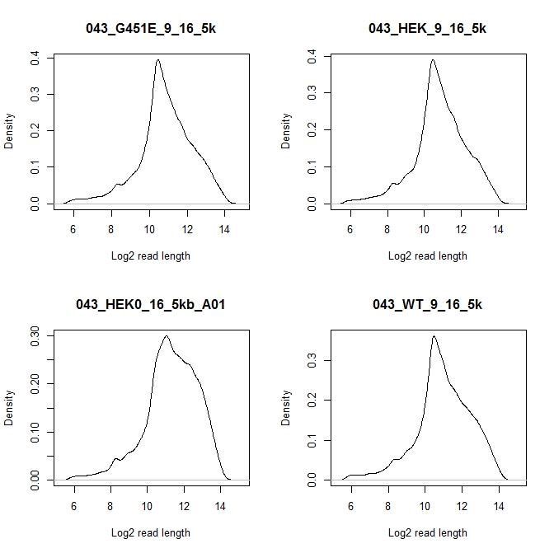
Read length distribution
2^10 = 1024
2^12 = 4096
2^13 = 8192

Slide 14
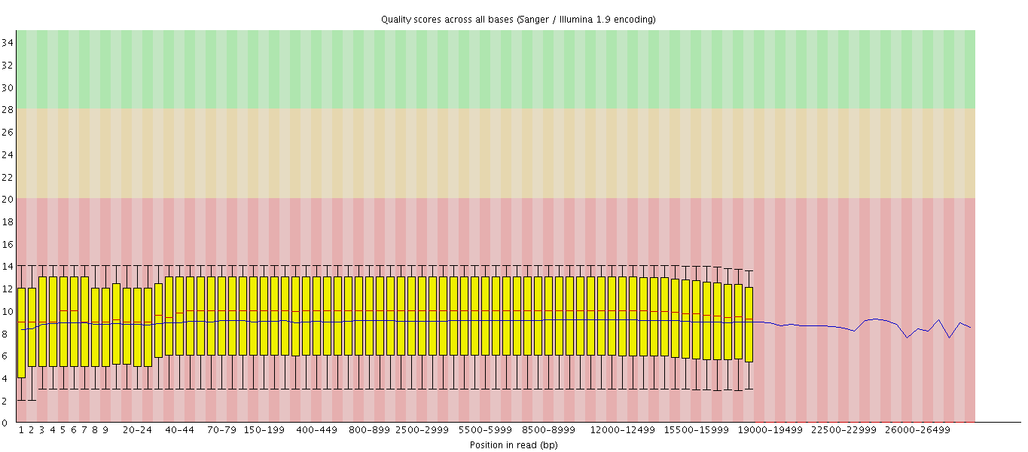
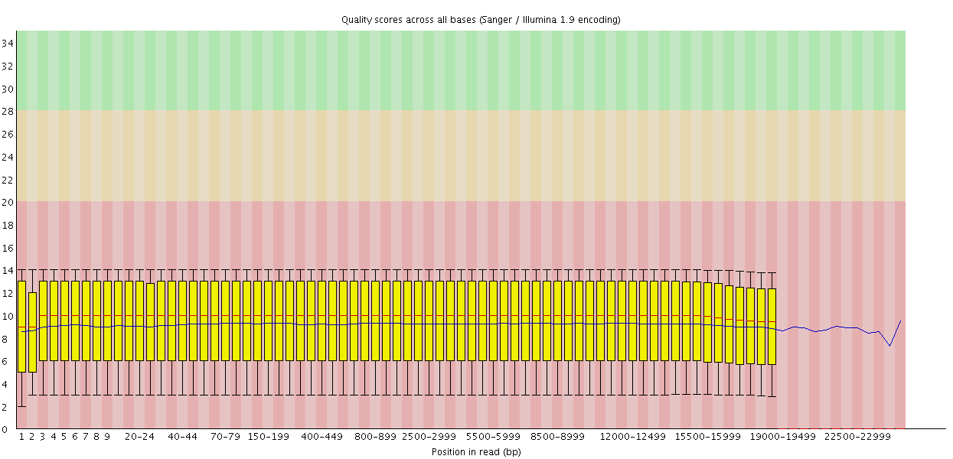
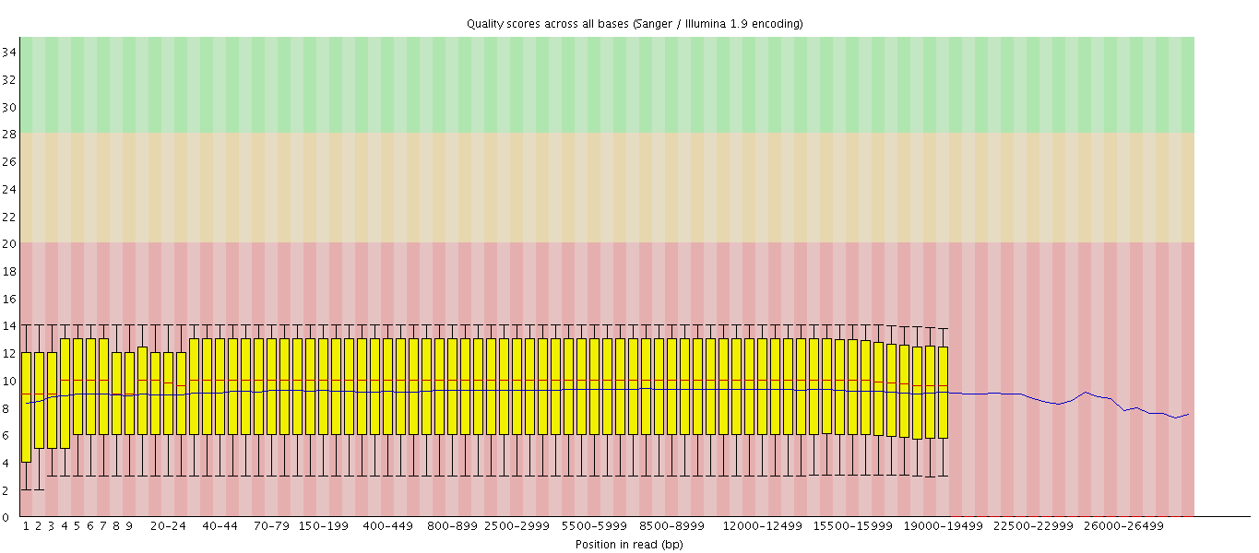
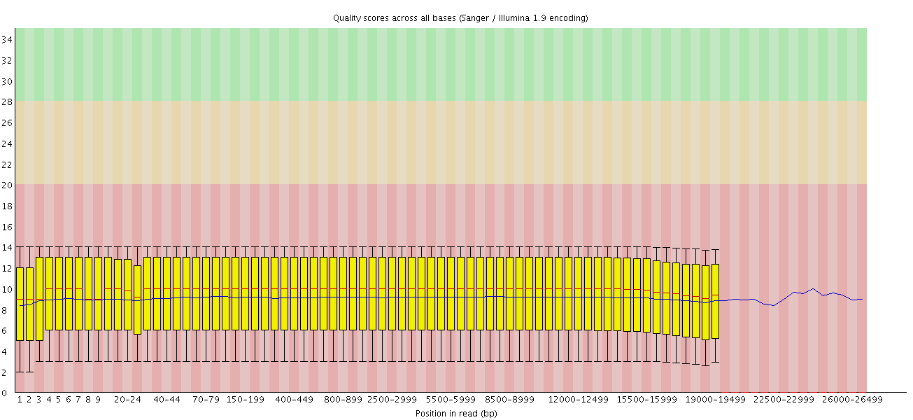
Base calling score examination

Slide 15
Fact about Illumina data
File | Num of reads | Num of n.t. | Average depth | Percent aligned (%)
G4451E_CTCTCTA-TAGATCG_L001_R1_001.fastq | 3,265,726 | 979,717,800 | 59,427 | 98.77
G4451E_CTCTCTA-TAGATCG_L001_R2_001.fastq | 3,265,726 | 979,717,800 | 59,427
HEK-0_CAGAGAG-TAGATCG_L001_R1_001.fastq | 3,682,224 | 1,104,667,200 | 67,006 | 99.16
HEK-0_CAGAGAG-TAGATCG_L001_R2_001.fastq | 3,682,224 | 1,104,667,200 | 67,006
HEK-9_GCTACGC-TAGATCG_L001_R1_001.fastq | 3,203,428 | 961,028,400 | 58,294 | 99.38
HEK-9_GCTACGC-TAGATCG_L001_R2_001.fastq | 3,203,428 | 961,028,400 | 58,294
WT-9_CGAGGCT-TAGATCG_L001_R1_001.fastq | 3,096,683 | 929,004,900 | 56,351 | 99.28
WT-9_CGAGGCT-TAGATCG_L001_R2_001.fastq | 3,096,683 | 929,004,900 | 56,351

Slide 16
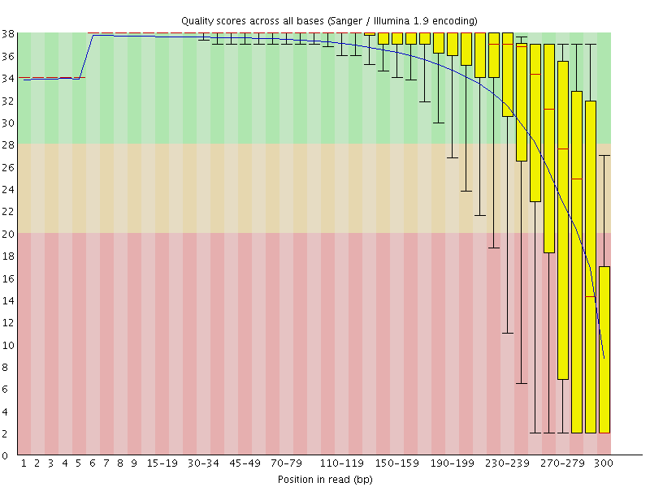
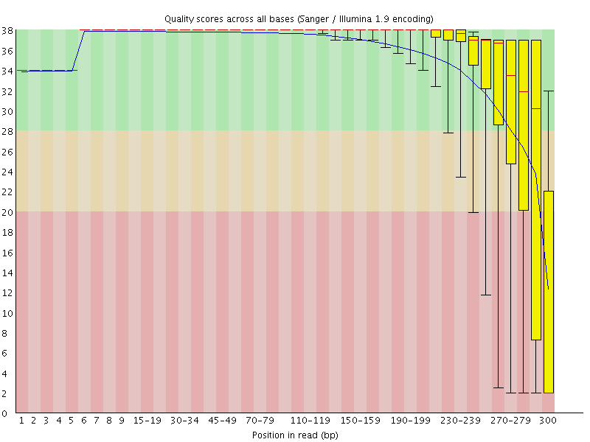
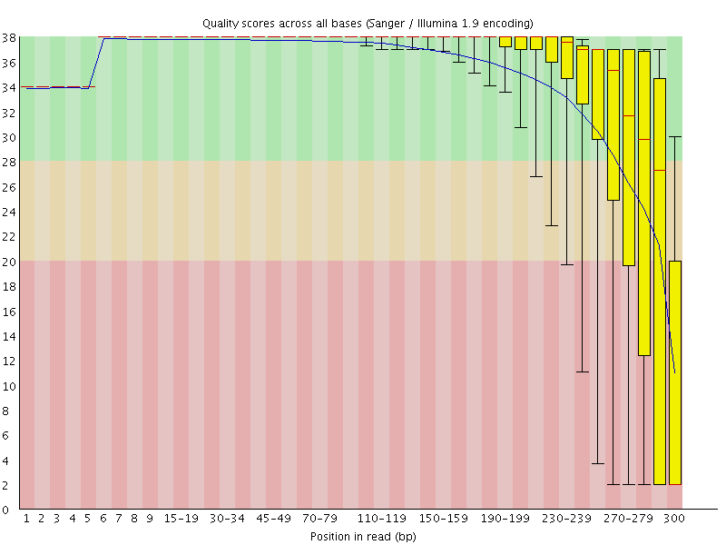

G451E
HEK-9
HEK-0
WT-9

Slide 17
SMRT Portal

Slide 18
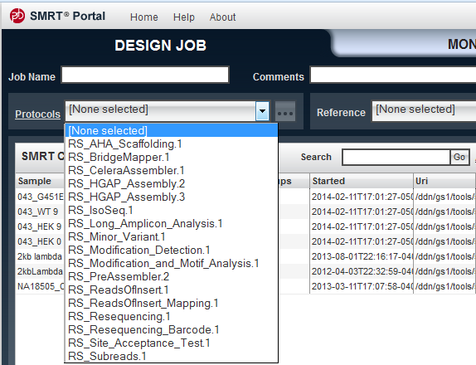
Available protocols (relevant)
Reported

Slide 19
BridgeMapper
Allow user to generate split alignments (split-read mapping)
Reads are filtered, mapped to the reference sequence
Consensus and variants are identified against the reference
Haploid variants and small indels are called during consensus

Slide 20
BridgeMapper @ params
Filtering (SFilter, v1)
MinRLength: 50
MinPolyQual: 75
MinPolyRlength: 50
Mapping (blasr, v1)
MaxDiv: 30%
MinAnchor: 12
Consensus (Quiver, v1)
Quiver
BridgeMapper
MinAffixLen: 50
MinRootLen: 250
Notes:
Quiver is a more sophisticated algorithm that provides additional information about each read, allowing more accurate consensus calls. Quiver does not use the alignment provided by the mapper except for determining how to group reads together at the gross level. Quivert implicitly performs its own realignment, so it is highly sensitive to all variant types, including indels.

Slide 21
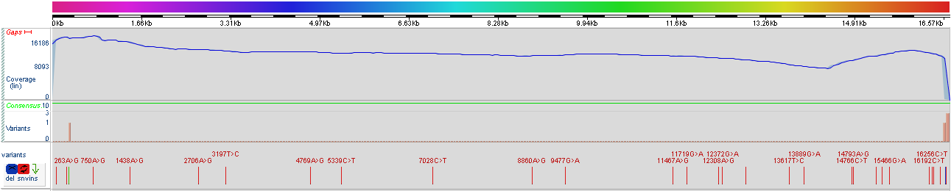
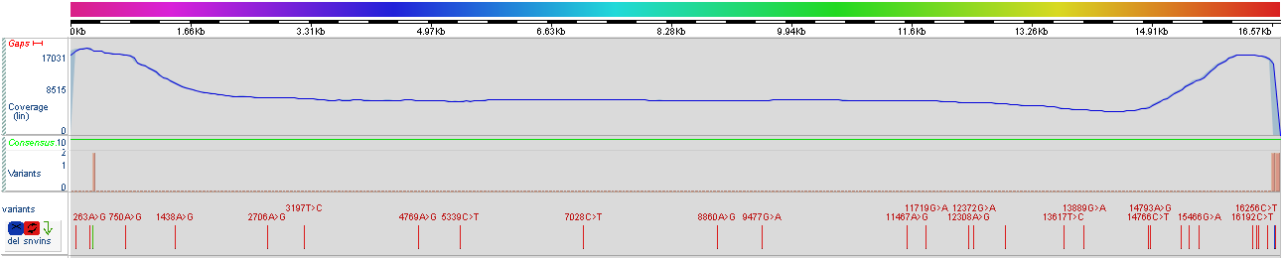
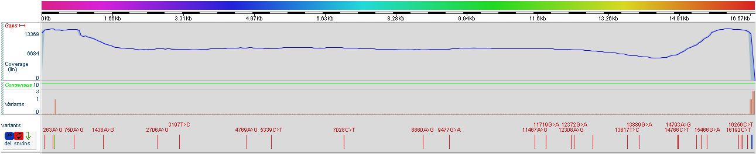
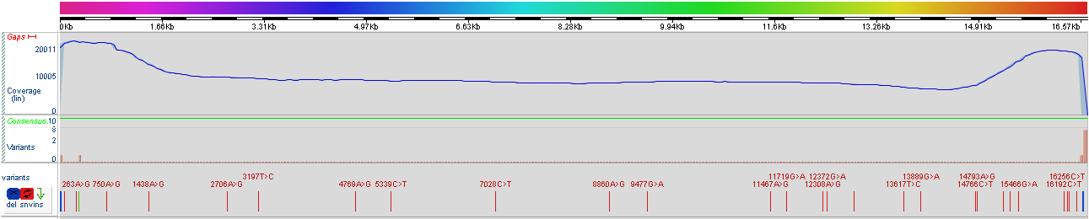
HEK_0
HEK_9
WT_9
G451E_9

Slide 22
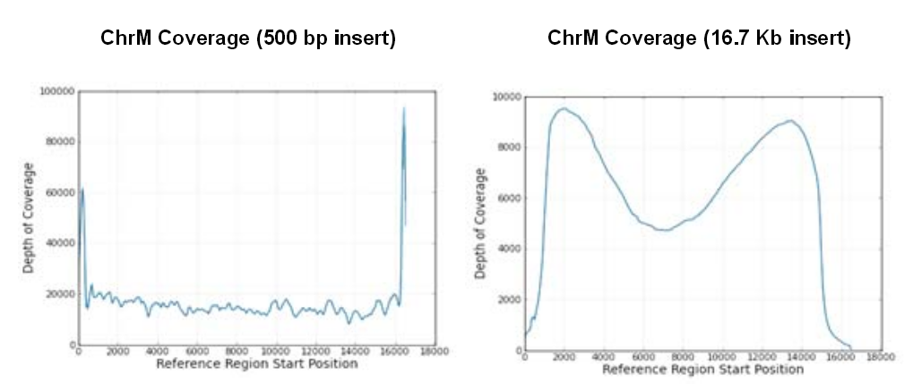

A public research report
English, A, et al. poster at 2012 AGBT

Slide 23
 | Common (HEK_0, HEK_9, WT_9 & G451E)
Type | Position | Position2 | DelType | Coverage
substitution | 73 | 73 | id=73A>G | coverage=100
substitution | 263 | 263 | id=263A>G | coverage=100
insertion | 302 | 302 | id=302_303insC | coverage=100
insertion | 310 | 310 | id=310_311insC | coverage=100
substitution | 750 | 750 | id=750A>G | coverage=100
substitution | 1438 | 1438 | id=1438A>G | coverage=100
substitution | 2706 | 2706 | id=2706A>G | coverage=100
substitution | 3197 | 3197 | id=3197T>C | coverage=100
substitution | 4769 | 4769 | id=4769A>G | coverage=100
substitution | 5339 | 5339 | id=5339C>T | coverage=100
substitution | 7028 | 7028 | id=7028C>T | coverage=100
substitution | 8860 | 8860 | id=8860A>G | coverage=100
substitution | 9477 | 9477 | id=9477G>A | coverage=100
substitution | 11467 | 11467 | id=11467A>G | coverage=100
substitution | 11719 | 11719 | id=11719G>A | coverage=100
substitution | 12308 | 12308 | id=12308A>G | coverage=100
substitution | 12372 | 12372 | id=12372G>A | coverage=100
substitution | 12801 | 12801 | id=12801C>T | coverage=100
substitution | 13617 | 13617 | id=13617T>C | coverage=100
substitution | 13889 | 13889 | id=13889G>A | coverage=100
substitution | 14766 | 14766 | id=14766C>T | coverage=100
substitution | 14793 | 14793 | id=14793A>G | coverage=100
substitution | 15218 | 15218 | id=15218A>G | coverage=100
substitution | 15326 | 15326 | id=15326A>G | coverage=100
substitution | 15466 | 15466 | id=15466G>A | coverage=100
substitution | 16192 | 16192 | id=16192C>T | coverage=100
substitution | 16256 | 16256 | id=16256C>T | coverage=100
substitution | 16270 | 16270 | id=16270C>T | coverage=100
substitution | 16399 | 16399 | id=16399A>G | coverage=100
deletion | 16497 | 16498 | id=16497delAC | coverage=100
deletion | 16503 | 16503 | id=16503delG | coverage=100

Slide 24
Type | Position | Position2 | DelType | Coverage
 | Unique to G451E
substitution | 16504 | 16504 | id=16504G>C | coverage=100
deletion | 16507 | 16507 | id=16507delC | coverage=97
deletion | 16513 | 16518 | id=16513delTCAGGG | coverage=64
deletion | 12 | 12 | id=12delT | coverage=100
deletion | 17 | 17 | id=17delC | coverage=100
 | Unique to HEK_0
substitution | 16504 | 16504 | id=16504G>C | coverage=100
deletion | 16510 | 16511 | id=16510delAC | coverage=78
substitution | 16512 | 16512 | id=16512T>G | coverage=70
 | Unique to HEK_9
substitution | 16505 | 16505 | id=16505T>C | coverage=100
 | Unique to WT_9
substitution | 16505 | 16505 | id=16505T>C | coverage=100
deletion | 16507 | 16507 | id=16507delC | coverage=91

Slide 25
Illumina sequence analysis overview
Data quality assessed with FastQC
Short reads were aligned to
Human mitochondria genome
With Botie2 (aligner)
Alignment was analyzed with samtools
Indexed mito-genome
Sorted Sam/bam file
Created pileup files
Variant calling
VarScan
Pvalue (FET) < 0.01

Slide 26
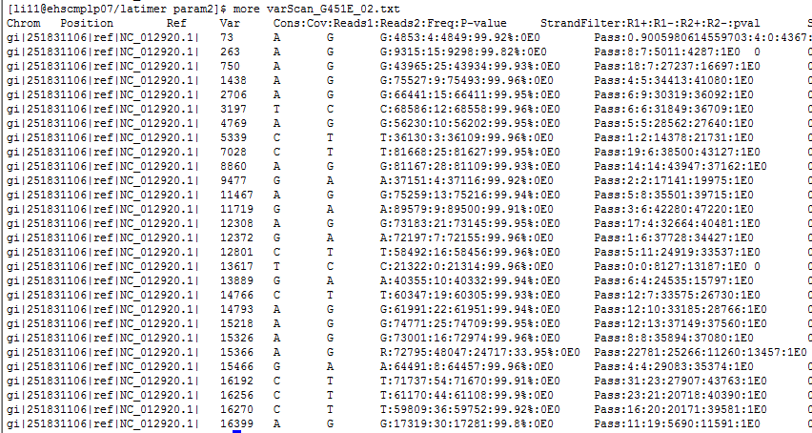
Variants (SNV) in G451E -- Illumina

Slide 27
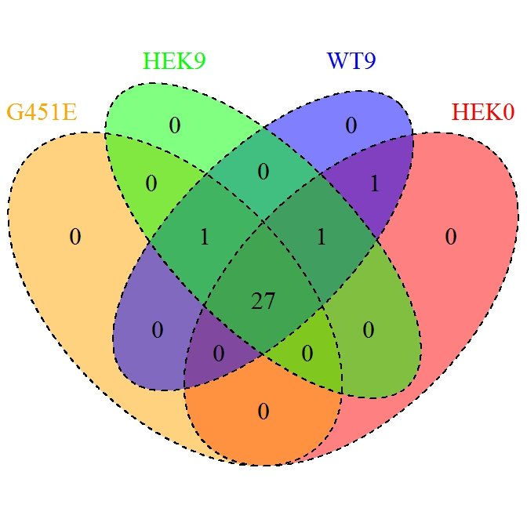
Variants across samples
Variants across all four samples

Slide 28
Common across two platforms
 | Illumina_VarScan |  |  |  |  | PacBio_BridgeMapper
Chrom | Position | Ref | Var | Cons:Cov:Reads1:Reads2:Freq:P-value | Type | DelType | Coverage
gi|251831106|ref|NC_012920.1| | 73 | A | G | G:5753:6:5747:99.9%:0E0 | substitution | id=73A>G | coverage=100
gi|251831106|ref|NC_012920.1| | 263 | A | G | G:14841:5:14833:99.94%:0E0 | substitution | id=263A>G | coverage=100
gi|251831106|ref|NC_012920.1| | 750 | A | G | G:53794:12:53779:99.97%:0E0 | substitution | id=750A>G | coverage=100
gi|251831106|ref|NC_012920.1| | 1438 | A | G | G:82494:3:82479:99.98%:0E0 | substitution | id=1438A>G | coverage=100
gi|251831106|ref|NC_012920.1| | 2706 | A | G | G:73930:14:73908:99.97%:0E0 | substitution | id=2706A>G | coverage=100
gi|251831106|ref|NC_012920.1| | 3197 | T | C | C:78084:7:78063:99.97%:0E0 | substitution | id=3197T>C | coverage=100
gi|251831106|ref|NC_012920.1| | 4769 | A | G | G:70025:20:69981:99.94%:0E0 | substitution | id=4769A>G | coverage=100
gi|251831106|ref|NC_012920.1| | 5339 | C | T | T:41904:7:41848:99.9%:0E0 | substitution | id=5339C>T | coverage=100
gi|251831106|ref|NC_012920.1| | 7028 | C | T | T:83474:22:83437:99.95%:0E0 | substitution | id=7028C>T | coverage=100
gi|251831106|ref|NC_012920.1| | 8860 | A | G | G:88880:26:88828:99.94%:0E0 | substitution | id=8860A>G | coverage=100
gi|251831106|ref|NC_012920.1| | 9477 | G | A | A:48635:15:48425:99.69%:0E0 | substitution | id=9477G>A | coverage=100
gi|251831106|ref|NC_012920.1| | 11467 | A | G | G:87677:10:87638:99.96%:0E0 | substitution | id=11467A>G | coverage=100
gi|251831106|ref|NC_012920.1| | 11719 | G | A | A:112822:16:112740:99.93%:0E0 | substitution | id=11719G>A | coverage=100
gi|251831106|ref|NC_012920.1| | 12308 | A | G | G:83274:37:83227:99.94%:0E0 | substitution | id=12308A>G | coverage=100
gi|251831106|ref|NC_012920.1| | 12372 | G | A | A:80649:13:80611:99.97%:0E0 | substitution | id=12372G>A | coverage=100
gi|251831106|ref|NC_012920.1| | 12801 | C | T | T:72376:21:72339:99.96%:0E0 | substitution | id=12801C>T | coverage=100
gi|251831106|ref|NC_012920.1| | 13617 | T | C | C:29534:0:29527:99.98%:0E0 | substitution | id=13617T>C | coverage=100
gi|251831106|ref|NC_012920.1| | 13889 | G | A | A:56762:12:56730:99.94%:0E0 | substitution | id=13889G>A | coverage=100
gi|251831106|ref|NC_012920.1| | 14766 | C | T | T:82582:15:82536:99.95%:0E0 | substitution | id=14766C>T | coverage=100
gi|251831106|ref|NC_012920.1| | 14793 | A | G | G:84002:27:83954:99.94%:0E0 | substitution | id=14793A>G | coverage=100
gi|251831106|ref|NC_012920.1| | 15218 | A | G | G:93660:35:93569:99.94%:0E0 | substitution | id=15218A>G | coverage=100
gi|251831106|ref|NC_012920.1| | 15326 | A | G | G:94385:13:94352:99.97%:0E0 | substitution | id=15326A>G | coverage=100
gi|251831106|ref|NC_012920.1| | 15466 | G | A | A:83720:15:83665:99.95%:0E0 | substitution | id=15466G>A | coverage=100
gi|251831106|ref|NC_012920.1| | 16192 | C | T | T:92762:54:92673:99.9%:0E0 | substitution | id=16192C>T | coverage=100
gi|251831106|ref|NC_012920.1| | 16256 | C | T | T:82454:47:82380:99.9%:0E0 | substitution | id=16256C>T | coverage=100
gi|251831106|ref|NC_012920.1| | 16270 | C | T | T:80810:22:80735:99.92%:0E0 | substitution | id=16270C>T | coverage=100
gi|251831106|ref|NC_012920.1| | 16399 | A | G | G:29498:43:29446:99.82%:0E0 | substitution | id=16399A>G | coverage=100

Slide 29
Effort on getting the indels
27 common variants cross samples/platforms
2 unique variants from PacBio (all 4 samples)
2 unique variants from PacBio (G541E only)
In Illumina platform
2 unique shared (WT9 & HEK0)
1 unique shared (WT9, HEK0 & HEK9)
1 unique shared (G451E, HEK9 & WT9)
Heteroplasmy plays the vital role
Variant (real) signal were largely diluted

Slide 30
“Unique” SNVs
 | Two common (all samples), two in G451E
Type | Position | Position2 | DelType | Coverage
insertion | 302 | 302 | id=302_303insC | coverage=100
insertion | 310 | 310 | id=310_311insC | coverage=100
deletion | 12 | 12 | id=12delT | coverage=100
deletion | 17 | 17 | id=17delC | coverage=100
WT9/HEK9/HEK0
Chrom | Position | Ref | Var | Cons:Cov:Reads1:Reads2:Freq:P-value
gi|251831106|ref|NC_012920.1| | 316 | G | C | S:5592:4245:1241:21.86%:0E0
WT9/HEK9/G451E
Chrom | Position | Ref | Var | Cons:Cov:Reads1:Reads2:Freq:P-value
gi|251831106|ref|NC_012920.1| | 15366 | A | G | R:72795:48047:24717:33.95%:0E0
WT9/HEK0
Chrom | Position | Ref | Var | Cons:Cov:Reads1:Reads2:Freq:P-value
gi|251831106|ref|NC_012920.1| | 316 | G | C | S:7727:5731:1873:23.85%:0E0
gi|251831106|ref|NC_012920.1| | 318 | T | C | Y:7661:5942:1578:20.41%:0E0

Slide 31
Custom tailored strategies
Searching for deletions – strategy I
Searching for deletions – strategy II
Searching for direct repeat – strategy III

Slide 32
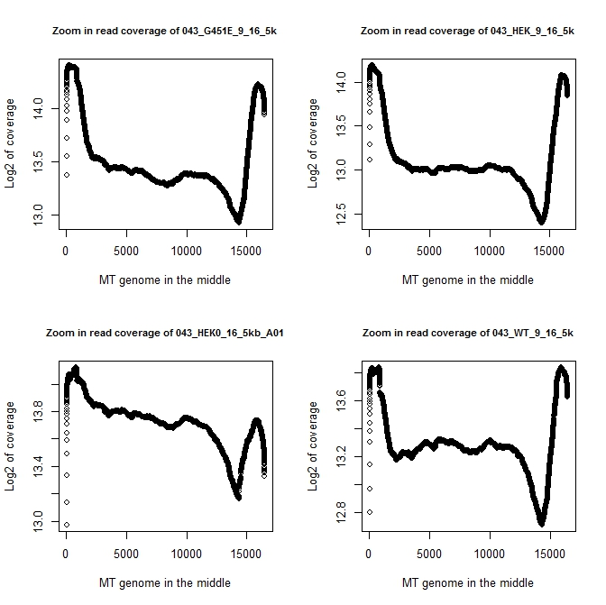

Slide 33
Step-change function smoothing
Read depth based approach
Window size = 1kb
Step = 100 bp
Threshold = 85% (mean_rd/overall_rd)
Two more parameter pairs were tested
Window: step @
500:50
50:10

Slide 34
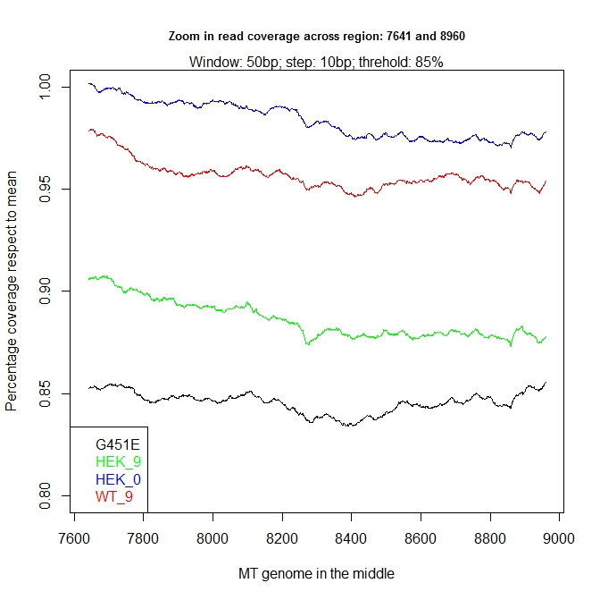
G451E

Slide 35
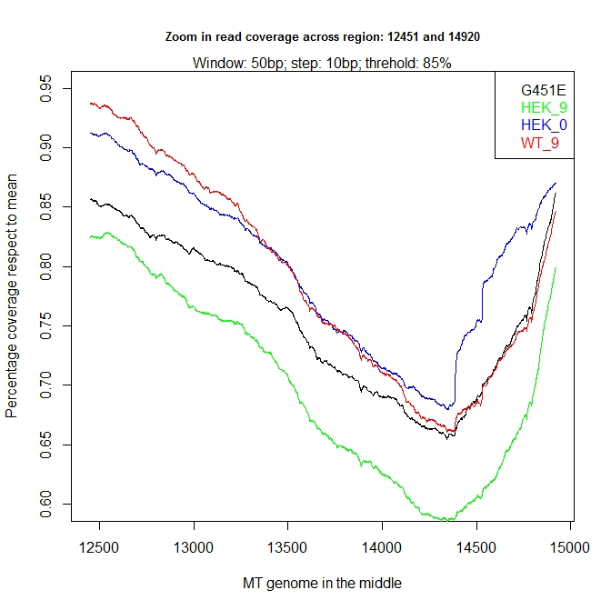
HEK_9

Slide 36
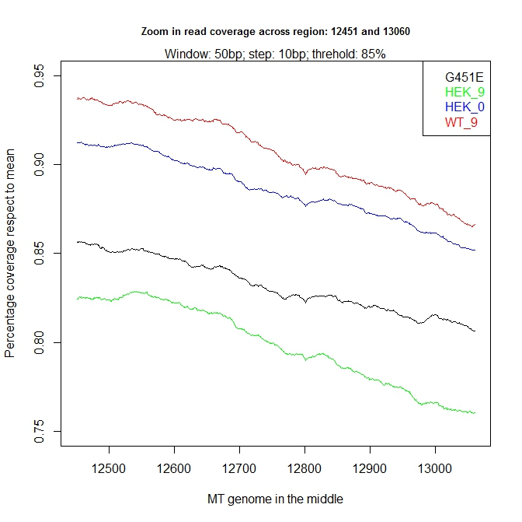
HEK_9

Slide 37
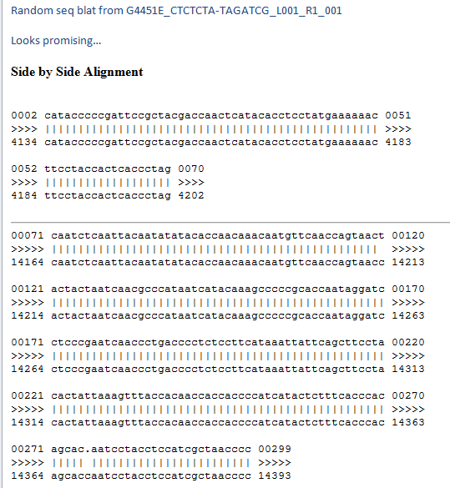
David Fargo

Slide 38
Custom tailored strategies
Searching for deletions – strategy I
Searching for deletions – strategy II
Searching for direct repeat – strategy III

Slide 39
This is what we are dealing
Linear mitochondria genome

Slide 40
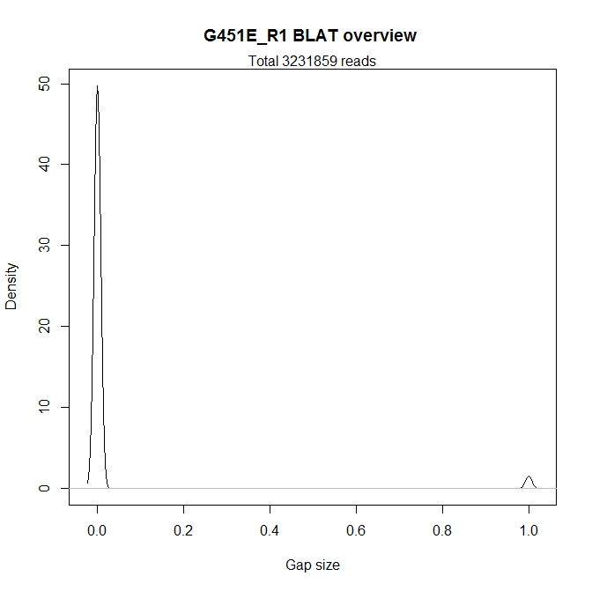
3073214 reads w/o gap
95.09%

Slide 41
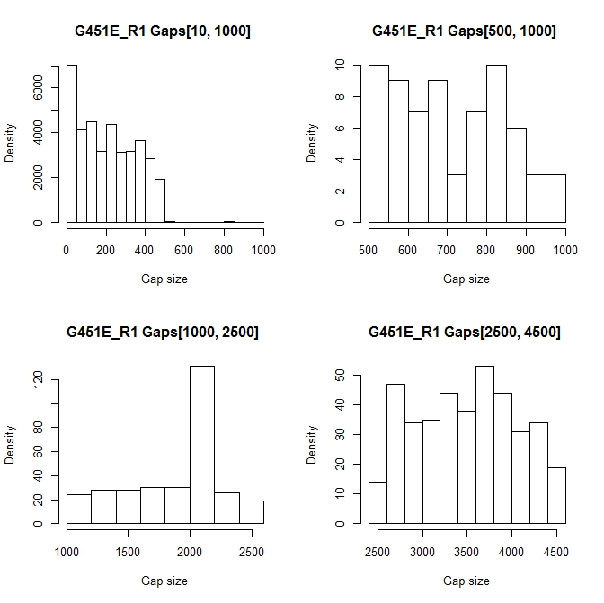

Slide 42
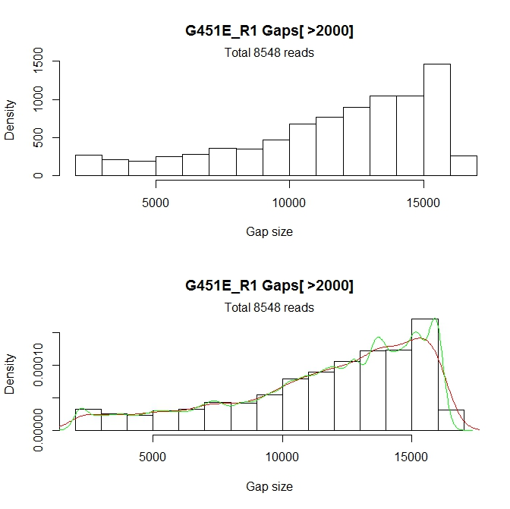

Slide 43
Getting the support for breaks workflow
Minimum break size: 2,000 bp
Maximum break size: 14,500 bp
For each read aligned
with break(s)
Determine the break start & end
Record one support all bases bound by [start, end]
Crawling along the mitochondria genome and get the “pileup” support for breaks

Slide 44
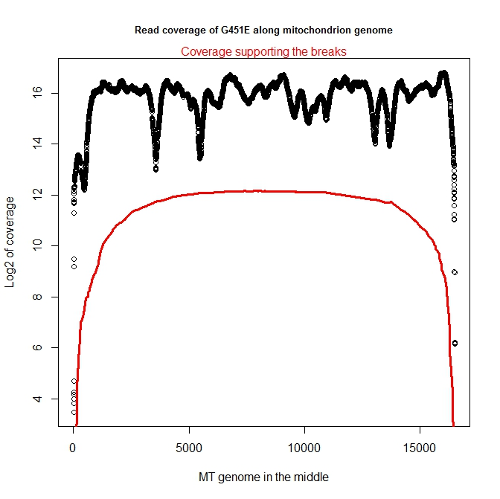
5-7%

Slide 45
Searching for breaks --sliding window
With the “break supporting pileup” data
Major parameter setting
Window size = 2000 bps
Step = 200 bps
Threshold = 1.4 times (variable)
Sliding along the mitochondrion genome
Report “significant” breaks candidates
If the mean support coverage (Window/Overall > threshold)

Slide 46
Searching for breaks --growing windows
Major parameter setting
Candidate break with size = 2000 bp
Grow pace = 100 bp
Threshold = 90% (10% reduced)
For each candidate break of 2000 bp
Grow each side by 100 bp
Stop if
The mean support coverage (extended/original < threshold)
Record the newly determined “breaks” (with various size)

Slide 47
Candidate breaks | G451E | HEK9 | HEK0 | WT-9
Index_1 | 6201 - 8200
Index_2 | 6401 - 8400
Index_3 | 6601 - 8600 |  |  | 6601 - 8600
Index_4 | 6801 - 8800 |  |  | 6801 - 8800
Index_5 | 7001 - 9000 |  |  | 7001 - 9000
Index_6 | 7201 - 9200 |  |  | 7201 - 9200
Index_7 | 7401 - 9400 |  | 7401 - 9400 | 7401 - 9400
Index_8 | 7601 - 9600 | 7601 - 9600 | 7601 - 9600 | 7601 - 9600
Index_9 | 7801 - 9800 | 7801 - 9800 | 7801 - 9800 | 7801 - 9800
Index_10 | 8001 - 10000 | 8001 - 10000 | 8001 - 10000 | 8001 - 10000
Index_11 | 8201 - 10200 | 8201 - 10200 | 8201 - 10200 | 8201 - 10200
Index_12 |  | 8401 - 10400 | 8401 - 10400 | 8401 - 10400
Index_13 |  | 8601 - 10600 | 8601 - 10600 | 8601 - 10600
Index_14 |  | 8801 - 10800 | 8801 - 10800 | 8801 - 10800
Index_15 |  | 9001 - 11000 | 9001 - 11000 | 9001 - 11000
Index_16 |  | 9201 - 11200 | 9201 - 11200 | 9201 - 11200
Index_17 |  | 9401 - 11400 | 9401 - 11400 | 9401 - 11400
Index_18 |  | 9601 - 11600 | 9601 - 11600 | 9601 - 11600
Index_19 |  | 9801 - 11800 | 9801 - 11800 | 9801 - 11800
Index_20 |  | 10001 - 12000 | 10001 - 12000 | 10001 - 12000
Index_21 |  | 10201 - 12200 | 10201 - 12200 | 10201 - 12200
Index_22 |  | 10401 - 12400 | 10401 - 12400 | 10401 - 12400
Index_23 |  | 10601 - 12600 | 10601 - 12600 | 10601 - 12600
Index_24 |  | 10801 - 12800 | 10801 - 12800 | 10801 - 12800
Index_25 |  | 11001 - 13000 | 11001 - 13000 | 11001 - 13000
Index_26 |  |  | 11201 - 13200 | 11201 - 13200
Index_27 |  |  | 11401 - 13400
Index_28 |  |  | 11601 - 13600

Slide 48
Candidate breaks | G451E | HEK9 | HEK0 | WT-9
Index_1 | 2001 - 12400
Index_2 | 2101 - 12700
Index_3 | 2201 - 13000
Index_4 | 2301 - 13300
Index_5 | 2401 - 13600
Index_6 | 2501 - 13900
Index_7 |  |  |  | 2601 - 12600
Index_8 | 2701 - 14100 |  |  | 2701 - 12900
Index_9 | 2801 - 14400 |  | 2901 - 13900 | 2901 - 13100
Index_10 | 3001 - 14600 | 3101 - 14100 | 3201 - 14000 | 3001 - 13400
Index_11 | 3301 - 14700 | 3401 - 14200 | 3601 - 14000 | 3101 - 13700
Index_12 | 3501 - 14900 | 3701 - 14300 | 3901 - 14100 | 3301 - 13900
Index_13 |  | 4001 - 14400 | 4301 - 14100 | 3501 - 14100
Index_14 |  | 4401 - 14400 | 4601 - 14200 | 3801 - 14200
Index_15 |  | 4701 - 14500 | 5001 - 14200 | 4101 - 14300
Index_16 |  | 5101 - 14500 | 5301 - 14300 | 4401 - 14400
Index_17 |  | 5401 - 14600 | 5701 - 14300 | 4701 - 14500
Index_18 |  | 5801 - 14600 | 6001 - 14400 | 5001 - 14600
Index_19 |  | 6101 - 14700 | 6301 - 14500 | 5301 - 14700
Index_20 |  | 6301 - 14900 | 6501 - 14700 | 5701 - 14700
Index_21 |  | 6601 - 15000 | 6801 - 14800 | 6001 - 14800
Index_22 |  | 6801 - 15200 | 7001 - 15000 | 6201 - 15000
Index_23 |  | 7101 - 15300 | 7301 - 15100 | 6501 - 15100
Index_24 |  | 7301 - 15500 | 7501 - 15300 | 6801 - 15200
Index_25 |  | 7601 - 15600 | 7801 - 15400 | 7101 - 15300
Index_26 |  | 7901 - 15700 | 8001 - 15600 | 7301 - 15500
Index_27 |  | 8101 - 15900 | 8301 - 15700 | 7601 - 15600
Index_28 |  |  | 8601 - 15800 | 7901 - 15700
Index_29 |  |  | 8901 - 15900 | 8201 - 15800
Index_30 |  |  | 9201 - 16000 | 8601 - 15800

Slide 49
Conclusion -- facing the reality
Heteroplasmy status is a given
Both PacBio and Illumina provided sufficient overage along mitochondrion genome
Data quality was sufficiently evaluated
27 common variants cross samples/platforms
Very few “unique variants” to PacBio
A hand full “unique variants” to Illumina platform
Overall breaks/deletion support was ~5-7%
Coverage-based approach proposed/tested
Identify “deletion”
Extended “deletion breaks”
Break/deletion of 2kb candidates were identified
Longer extended break/deletion of various length candidates were reported

Slide 50
Zoom in on those deletions
Search for nucleotide level “deletions”
Searching for pair-wise “significant deletion”
Searching for deletions flanked by “direct repeats”
“Deletion flanked with DirRep” differences

Slide 51
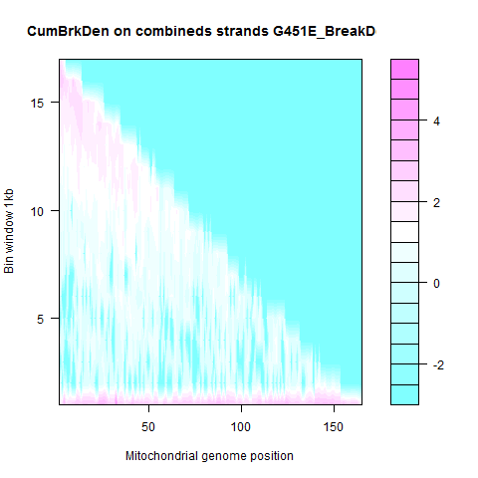
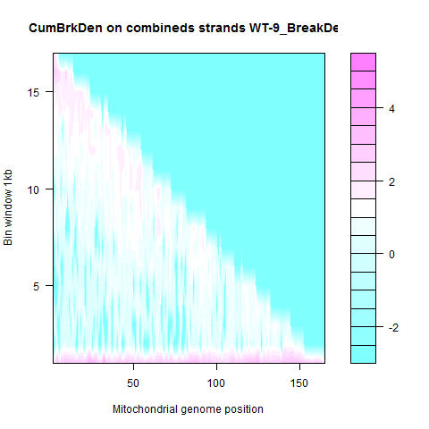
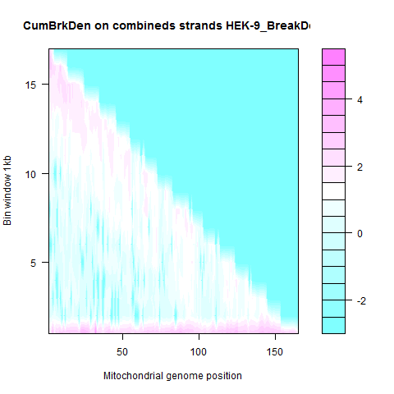
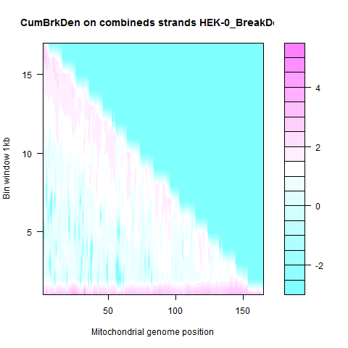

Slide 52
Cross-sample break density
Position | HEK-0 | G451E | HEK-9 | WT-9
1_1000 | 213679 | 200123 | 176868 | 184706
1001_2000 | 504 | 125 | 328 | 199
2001_3000 | 641 | 267 | 436 | 281
3001_4000 | 661 | 190 | 387 | 289
4001_5000 | 658 | 186 | 403 | 297
5001_6000 | 675 | 228 | 432 | 288
6001_7000 | 888 | 265 | 604 | 403
7001_8000 | 986 | 370 | 592 | 525
8001_9000 | 741 | 364 | 539 | 403
9001_10000 | 886 | 469 | 595 | 506
10001_11000 | 928 | 621 | 650 | 519
11001_12000 | 831 | 696 | 730 | 522
12001_13000 | 844 | 831 | 769 | 456
13001_14000 | 938 | 990 | 946 | 514
14001_15000 | 832 | 1102 | 941 | 526
15001_16000 | 1640 | 1552 | 1256 | 1349
16001_17000 | 638 | 268 | 344 | 305

Slide 53
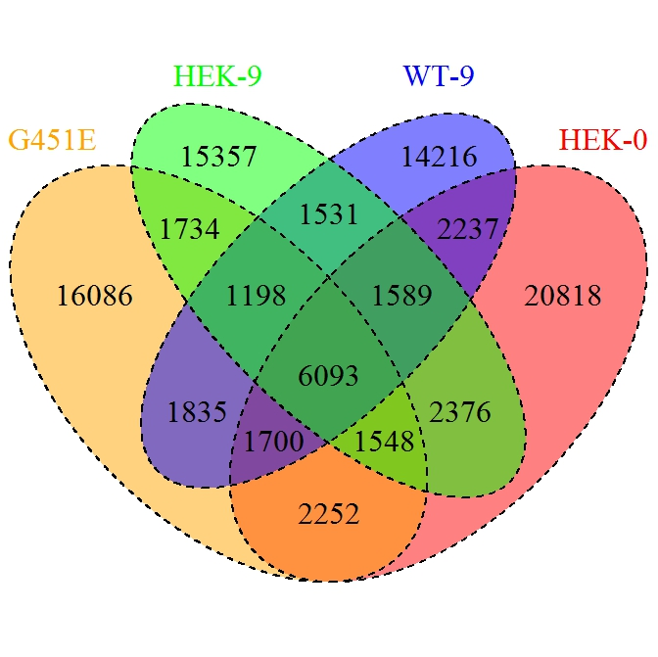
31426
30399
32446
38613

Slide 54
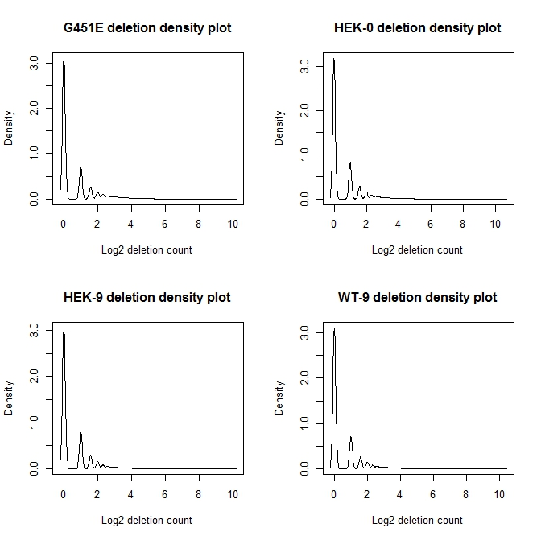

Slide 55

77
81
64
83
The number of deletion count is greater than 100 occurrences

Slide 56
Unique “deletions” > 100 counts
Deletion counts
DeletionJunction | G541E | HEK-0 | HEK-9 | WT-9 | DeletionSize
5764:5853 | 100 | N/A | N/A | N/A | 90
13716:15912 | 161 | N/A | N/A | N/A | 2197
2463:2652 | N/A | N/A | 114 | N/A | 190
2534:2652 | N/A | N/A | 105 | N/A | 119
2564:2652 | N/A | 117 | N/A | N/A | 89
2585:2652 | N/A | 138 | N/A | N/A | 68
2600:2652 | N/A | 133 | N/A | N/A | 53
9427:16150 | N/A | 108 | N/A | N/A | 6724
232:16159 | N/A | N/A | N/A | 110 | 15928
307:16184 | N/A | N/A | N/A | 103 | 15878
2365:2652 | N/A | N/A | N/A | 101 | 288
2411:2652 | N/A | N/A | N/A | 104 | 242
sample | :2652
G451E | 349
HEK0 | 364
HEK9 | 365
WT9 | 355

Slide 57
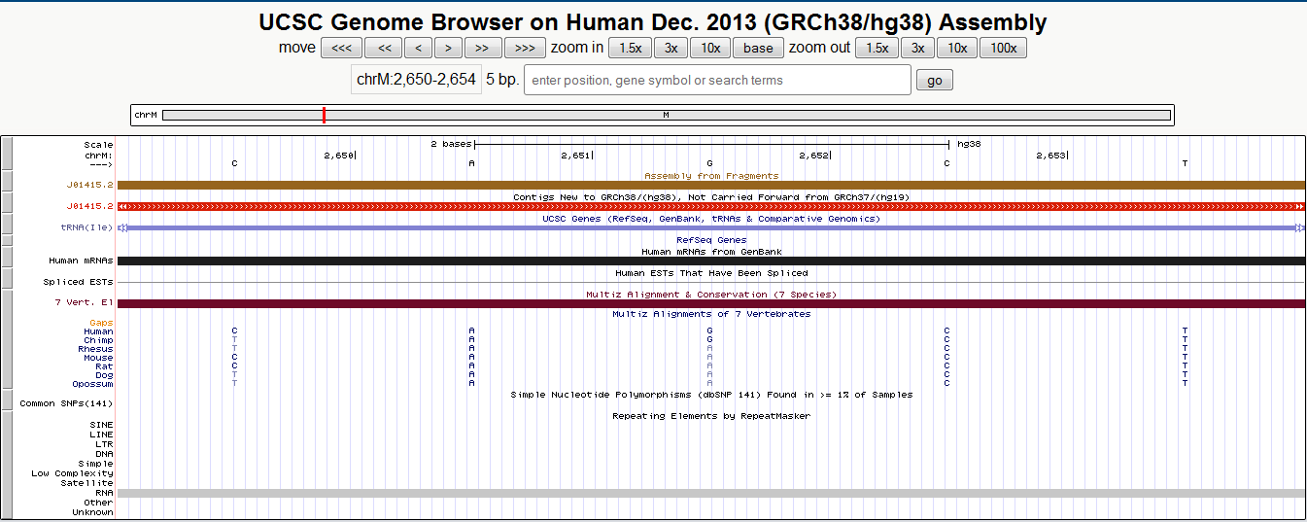
What is about chrm:2652 ??

Slide 58
For common deletions
Chi-square test for balance (pair-wise)
Pvalue < 0.001
Comparison | Num of deletions
G451E_cnt.vs.HEK-0_cnt | 30
G451E_cnt.vs.HEK-9_cnt | 11
G451E_cnt.vs.WT-9_cnt | 25
HEK-9_cnt.vs.HEK-0_cnt | 20
WT-9_cnt.vs.HEK-0_cnt | 16
WT-9_cnt.vs.HEK-9_cnt | 8

Slide 59
SigDiff deletion (p < 0.001)
DeletionJunction | G451E.vs.WT9 | G451E | WT9 | DeletionSize
9226:9538 | 3.73E-37 | 3 | 171 | 313
898:16114 | 6.80E-31 | 453 | 874 | 15217
9950:10107 | 1.19E-28 | 7 | 143 | 158
232:16159 | 1.88E-24 | 2 | 110 | 15928
3107:3107 | 1.59E-11 | 1003 | 723 | 1
2537:2652 | 1.54E-10 | 868 | 1156 | 116
307:16184 | 9.92E-10 | 32 | 103 | 15878
2248:2652 | 2.23E-09 | 386 | 571 | 405
2293:2652 | 4.06E-07 | 385 | 539 | 360
2172:2652 | 2.01E-05 | 225 | 325 | 481
2323:2652 | 2.61E-05 | 141 | 221 | 330
2312:2652 | 3.18E-05 | 266 | 371 | 341
9427:16150 | 3.43E-05 | 10 | 39 | 6724
2272:2652 | 4.90E-05 | 221 | 315 | 381
2291:2652 | 6.99E-05 | 601 | 747 | 362
2491:2652 | 7.44E-05 | 357 | 471 | 162
2284:2653 | 9.53E-05 | 498 | 629 | 370
2393:2652 | 0.00018095 | 362 | 470 | 260
15500:15534 | 0.000208334 | 142 | 86 | 35
229:16156 | 0.000295043 | 152 | 222 | 15928
14981:15142 | 0.000328154 | 219 | 150 | 162
2301:2652 | 0.000339237 | 245 | 331 | 352
2200:2652 | 0.000700455 | 80 | 129 | 453
2358:2652 | 0.000706416 | 173 | 242 | 295
2342:2652 | 0.000712781 | 294 | 382 | 311

Slide 60
Custom tailored strategies
Searching for deletions – strategy I
Searching for deletions – strategy II
Searching for direct repeat – strategy III

Slide 61
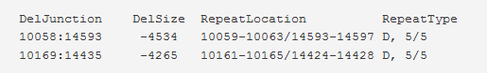
Known DirRep from mitomap
In the first case, the deletion starts at 10058, right before the first repeat (10059-10063); and ends at 14593, right before the second “direct repeat” starts. As a result, one repeat (10059-10063) disappears.
In the second case, the deletion starts at 10169, after the first repeat (10161-10165); and ends at 14435, which contains that the second “direct repeat”. As a result, one repeat (14424-14428) disappears.

Slide 62
Search for direct repeat
Align both ends against their possible repeat counterpart
For any given deletion
“del” >= 15 bps
Expand search 15 bp on both ends
Perform exhaustive searching and document
significant alignment (e-scores) candidates

Slide 63
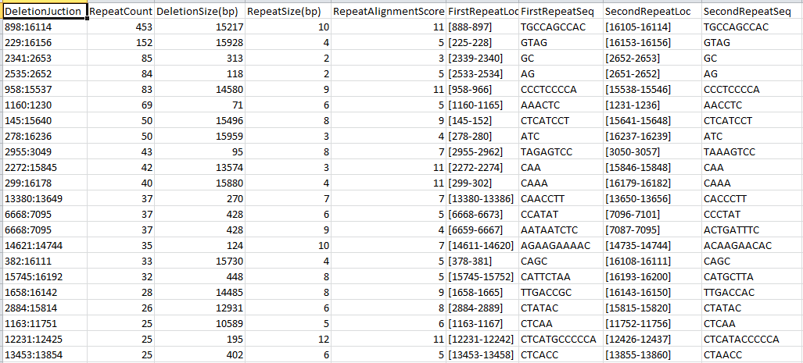
Direct repeat results (G451E)
Missing in HEK-9

Slide 64

5490
4654
4327
7791

Slide 65
For common deletions (891)
Chi-square test for balance (pair-wise)
Pvalue < 0.001
Comparison | Num of deletions
G451E_cnt.vs.HEK-0_cnt | 99
G451E_cnt.vs.HEK-9_cnt | 36
G451E_cnt.vs.WT-9_cnt | 25
HEK-9_cnt.vs.HEK-0_cnt | 24
WT-9_cnt.vs.HEK-0_cnt | 29
WT-9_cnt.vs.HEK-9_cnt | 7

Slide 66
Significant deletions flanked by direct repeats
DeletionJunction | G451E.vs.WT-9 | G451E | WT-9 | DeletionSize
232:16159 | 3.25E-47 | 4 | 220 | 15928
6336:13998 | 3.22E-33 | 10 | 172 | 7663
898:16114 | 6.80E-31 | 453 | 874 | 15217
7726:15825 | 2.00E-13 | 12 | 84 | 8100
6468:14136 | 9.64E-08 | 2 | 34 | 7669
12023:16147 | 3.46E-07 | 3 | 34 | 4125
4643:16059 | 5.97E-07 | 8 | 44 | 11417
6401:15825 | 7.39E-07 | 26 | 76 | 9425
278:16236 | 3.14E-06 | 50 | 13 | 15959
5337:15814 | 3.86E-06 | 8 | 40 | 10478
3678:11751 | 1.60E-05 | 2 | 24 | 8074
1720:15521 | 2.21E-05 | 28 | 4 | 13802
9427:16150 | 3.43E-05 | 10 | 39 | 6724
2375:13834 | 4.46E-05 | 22 | 2 | 11460
8569:15832 | 0.000161316 | 6 | 28 | 7264
6531:13830 | 0.000162132 | 5 | 26 | 7300
9103:15820 | 0.000204761 | 16 | 45 | 6718
299:16178 | 0.000208297 | 40 | 13 | 15880
229:16156 | 0.000295043 | 152 | 222 | 15928
11713:15700 | 0.000346619 | 2 | 18 | 3988
12206:16327 | 0.000358523 | 8 | 30 | 4122
1160:1230 | 0.000364507 | 69 | 33 | 71
958:15537 | 0.000365966 | 83 | 43 | 14580
3798:15409 | 0.000406952 | 26 | 6 | 11612
6523:15814 | 0.000643698 | 6 | 25 | 9292

Slide 67
Unique deletion flanked by DirRep
Repeat count | HEK-0 | HEK-9 | G451E | WT-9
Total | 4262 | 2406 | 1898 | 1852
1 | 2771 | 1575 | 1360 | 1324
2 | 1160 | 701 | 434 | 450
3-5 | 307 | 118 | 77 | 67
6-9 | 23 | 10 | 13 | 9
10 and up | 1 | 2 | 14 | 2
G451E = 0.68%
G451E ~ 0.74%

Slide 68
Sample | DeletionJuction | RepeatCount | DeletionSize(bp) | RepeatSize(bp) | RepeatAlignmentScore | FirstRepeatLoc | FirstRepeatSeq | SecondRepeatLoc | SecondRepeatSeq
G451E | 1239:16114 | 10 | 14876 | 2 | 3 | [1237-1238] | AC | [16113-16114] | AC
 | 145:15885 | 11 | 15741 | 1 | 2 | [144-144] | C | [15885-15885] | C
 | 179:16027 | 18 | 15849 | 2 | 7 | [179-180] | TT | [16028-16029] | TT
 | 2088:16100 | 11 | 14013 | 2 | 7 | [2088-2089] | TT | [16101-16102] | TT
 | 233:16153 | 13 | 15921 | 5 | 7 | [233-237] | TAATA | [16154-16158] | TAGTA
 | 281:15181 | 10 | 14901 | 7 | 6 | [281-287] | ATAACAA | [15182-15188] | ATTACAA
 | 295:15663 | 10 | 15369 | 6 | 5 | [295-300] | CCACCA | [15664-15669] | CCTCCA
 | 304:15925 | 14 | 15622 | 3 | 4 | [301-303] | AAC | [15923-15925] | AAC
 | 3162:14928 | 11 | 11768 | 5 | 6 | [3162-3166] | CGCCT | [14929-14933] | CGCCT
 | 3415:15542 | 11 | 12129 | 3 | 4 | [3415-3417] | CCC | [15543-15545] | CCC
 | 677:15852 | 10 | 15176 | 2 | 3 | [677-678] | CT | [15853-15854] | CT
 | 685:15604 | 11 | 14920 | 2 | 3 | [685-686] | AA | [15605-15606] | AA
 | 828:15781 | 14 | 14954 | 2 | 6 | [828-829] | CC | [15782-15783] | CC
 | 984:15625 | 19 | 14642 | 2 | 3 | [984-985] | CT | [15626-15627] | CT
HEK0 | 261:313 | 10 | 51 | 6 | 7 | [261-266] | CCACTT | [314-319] | CCGCTT
HEK9 | 167:12348 | 10 | 12182 | 4 | 5 | [163-166] | GCAC | [12345-12348] | GCAC
 | 298:16167 | 11 | 15870 | 6 | 5 | [298-303] | CCAAAC | [16168-16173] | CCAATC
WT9 | 1194:15370 | 12 | 14177 | 3 | 4 | [1194-1196] | CTA | [15371-15373] | CTA
 | 233:15920 | 11 | 15688 | 2 | 3 | [233-234] | TA | [15921-15922] | TA

Slide 69
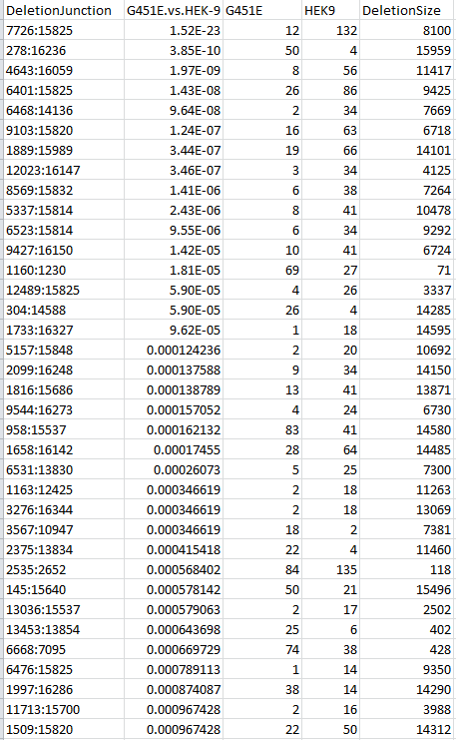

Slide 70
Conclusion/discussion
A unique deletion in G451E sample
Genome concordance: 13716:15912
Deletion size: 2197
Number of occurrence: 161
One deletion was missing in HEK9
Genome concordance: 382:16111
Deletion size: 15730
Unbalanced occurrence observed in others
G451E (33), HEK0 (25), WT9 (9)
Pair-wise significant deletions reported
Unexpected number of deletions end at 2652
With similar number of occurrence

Slide 71
Conclusion/discussion – cont.
Deletions flanked with direct repeat were determined
A unique deletion shared by G451E and HEK9
Genome concordance: 1707:16107
Deletion size: 14401
Disproportion between G451E:HEK9 @ 16:2
Pair-wise significant deletions flanked with direct repeats were determined
Among unique deletion flanked by DirRep
Majorities were at very low frequency
G451E had the largest number of deletions with more than 10 occurrence
Unique deletions with 10 or more occurrences tended to be large
Future goals
Need a valid statistic for “occurrence of deletion”
Need to follow up on “potential candidates”

Slide 72

Effort in selected projects
NGS in a mitochondria project
A mechanistic strategy to inform combination toxicity
Circos on a VirtualMachine
Recently, just responded to review comment

Slide 73
Experimental rationale
Experimental design
Two anti-cancer agents: topotecan and oxaliplatin
Administration sequence: which one first
Three time points: 1, 6 and 24 hours
Two vehicle controls: 0.9% NaCL and D5W
Objectives
Molecular responses to single agent vs double agents
Whether sequence of administration matters
Dose and time effect
Analysis plan
EPIG pattern extraction
Limma/ANOVA based on DEG
Clustering on genes and pathways
Biological enrichment analysis

Slide 74
Group | Treatment | Dose of Topotecan (mg/kg) | Dose of Oxaliplatin (mg/kg) | No. Animals per Group | No. Animals per Necropsy Time point (Hours)
 |  |  |  |  | 1 | 6 | 24
1 | 0.9% NaCl (30 min infusion) followed by D5W (30 min infusion) | 0 | 0 | 12 | 4 | 4 | 4
2 | D5W (30 min infusion) followed by 0.9% NaCl (30 min infusion) | 0 | 0 | 12 | 4 | 4 | 4
3 | Topotecan (30 min infusion) followed by D5W (30 min infusion) | 4.7 (first infusion) | 0 | 12 | 4 | 4 | 4
4 | Oxaliplatin (30 min infusion) followed by 0.9% NaCl (30 min infusion) | 0 | 15 (first infusion) | 12 | 4 | 4 | 4
5 | Topotecan (30 min infusion) followed by Oxaliplatin (30 min infusion) | 4.7 (first infusion) | 15 (second infusion) | 12 | 4 | 4 | 4
6 | Oxaliplatin (30 min infusion) followed by Topotecan (30 min infusion) | 4.7 (second infusion) | 15 (first infusion) | 12 | 4 | 4 | 4
7 | 0.9% NaCl (30 min infusion) followed by Oxaliplatin (30 min infusion) | 0 | 15 (second infusion) | 12 | 4 | 4 | 4
8 | D5W (30 min infusion) followed by Topotecan (30 min infusion) | 4.7 (second infusion) | 0 | 12 | 4 | 4 | 4

Slide 75
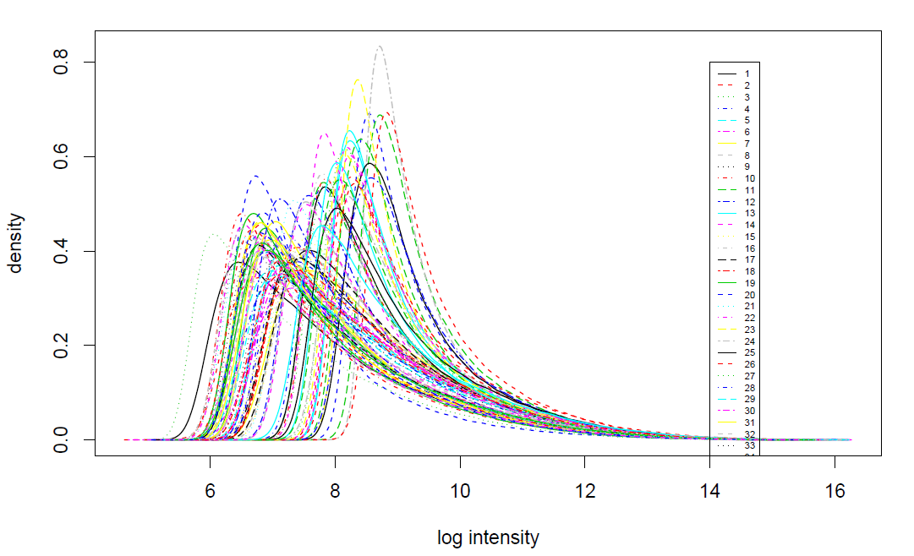
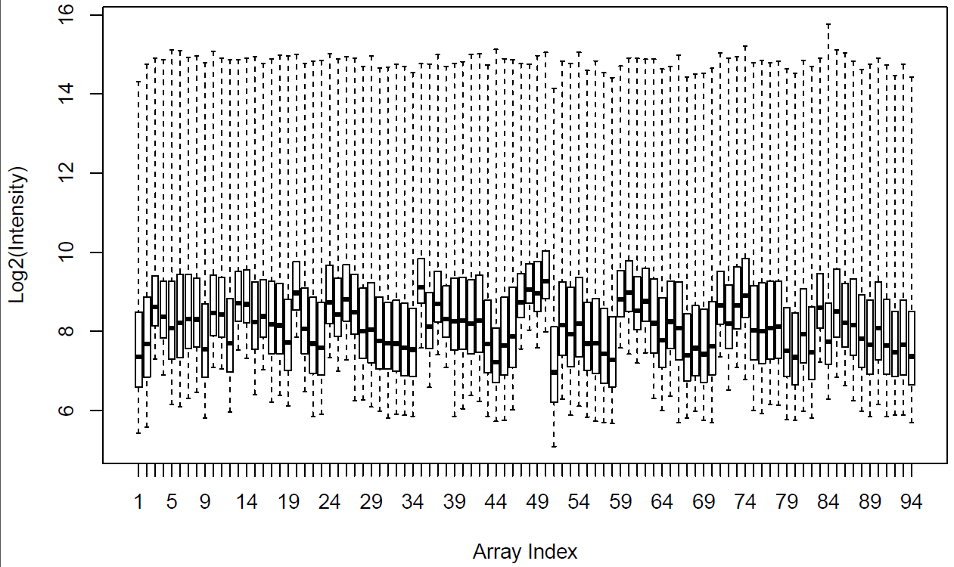
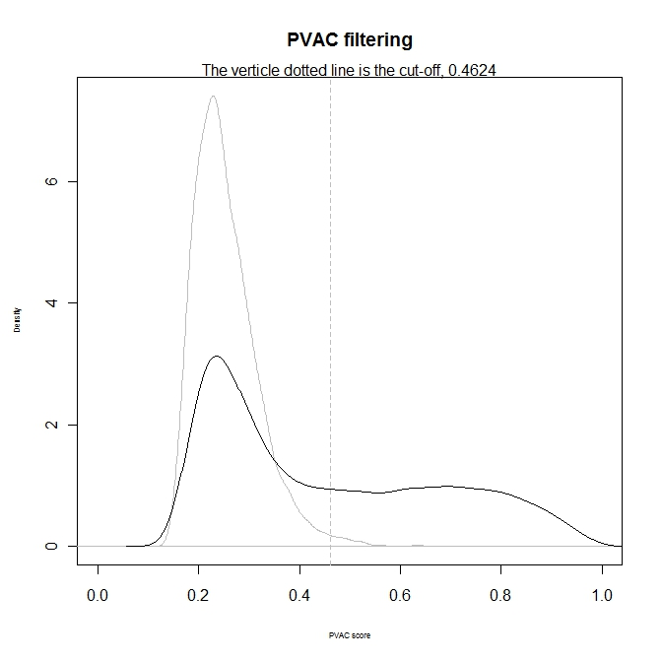
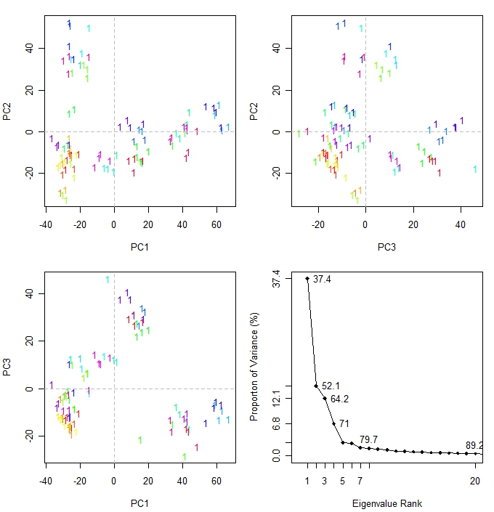

Slide 76
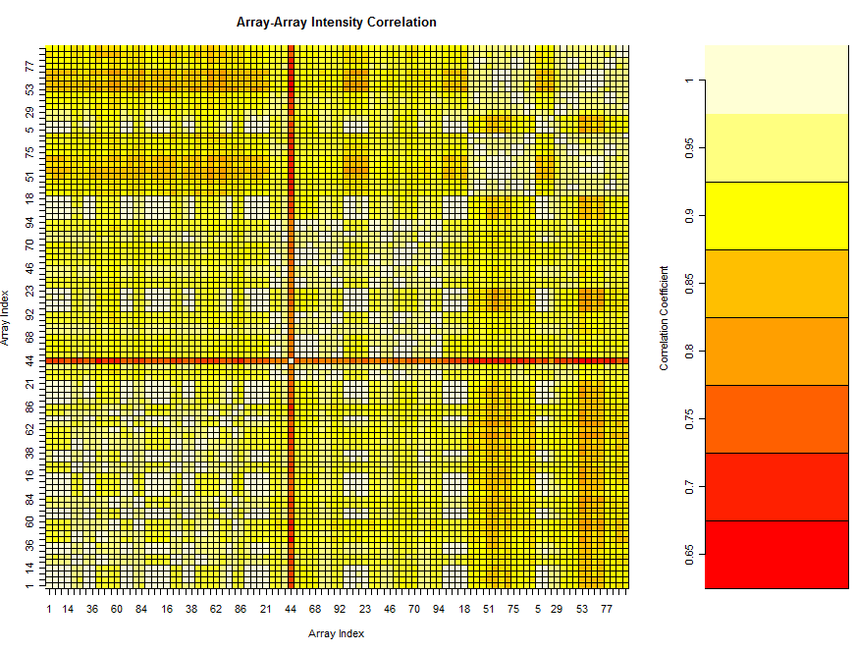
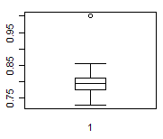
1344-05H

Slide 77
BH-FDR < 0.05 & FC > 2 --1 hours
Treatment | GeneSpring Group Name | Comparator Group | DEG
0.9% NaCl (30 minute infusion) followed by D5W (30 minute infusion) | CTRL1 | CTRL1 | N/A
D5W (30 minute infusion) followed by 0.9% NaCl (30 minute infusion) | CTRL2 | CTRL2 | N/A
Topotecan (30 minute infusion) followed by D5W (30 minute infusion) | TopoD5W | 3 vs CTRL1 (To.vs.Ctrl1) | 378
Oxaliplatin (30 minute infusion) followed by 0.9% NaCl (30 minute infusion) | OxaliNacl | 4 vs CTRL2 (Ox.vs.Ctrl2) | 23
Topotecan (30 minute infusion) followed by Oxaliplatin (30 minute infusion) | ToOx | 5 vs CTRL1 (ToOx.vs.Ctrl1) | 591
 | ToOx_OxTo | CoupleSeq 5 vs. 6 | 92
 | ToOx_CtrlOX | CoupleSingle 5 vs. 7 | 429
Oxaliplatin (30 minute infusion) followed by Topotecan (30 minute infusion) | OxTo | 6 vs CTRL2 (OxTo.vs.Ctrl2) | 688
 | OxTo_CtrlTo | CoulpleSingle 6 vs. 8 | 3
0.9% NaCl (30 minute infusion) followed by Oxaliplatin (30 minute infusion) | NaclOxali | 7 vs CTRL1 (Ox.vs.Ctrl1) | 5
D5W (30 minute infusion) followed by Topotecan (30 minute infusion) | D5WTopo | 8 vs CTRL2 (To.vs.Ctrl2) | 455

Slide 78
BH-FDR < 0.05 & FC > 2 --6 hours
Treatment | GeneSpring Group Name | Comparator Group | DEG
0.9% NaCl (30 minute infusion) followed by D5W (30 minute infusion) | CTRL1 | CTRL1 | N/A
D5W (30 minute infusion) followed by 0.9% NaCl (30 minute infusion) | CTRL2 | CTRL2 | N/A
Topotecan (30 minute infusion) followed by D5W (30 minute infusion) | TopoD5W | 3 vs CTRL1 (To.vs.Ctrl1) | 641
Oxaliplatin (30 minute infusion) followed by 0.9% NaCl (30 minute infusion) | OxaliNacl | 4 vs CTRL2 (Ox.vs.Ctrl2) | 167
Topotecan (30 minute infusion) followed by Oxaliplatin (30 minute infusion) | ToOx | 5 vs CTRL1 (ToOx.vs.Ctrl1) | 793
 | ToOx_OxTo | CoupleSeq 5 vs. 6 | 16
 | ToOx_CtrlOX | CoupleSingle 5 vs. 7 | 181
Oxaliplatin (30 minute infusion) followed by Topotecan (30 minute infusion) | OxTo | 6 vs CTRL2 (OxTo.vs.Ctrl2) | 832
 | OxTo_CtrlTo | CoulpleSingle 6 vs. 8 | 48
0.9% NaCl (30 minute infusion) followed by Oxaliplatin (30 minute infusion) | NaclOxali | 7 vs CTRL1 (Ox.vs.Ctrl1) | 124
D5W (30 minute infusion) followed by Topotecan (30 minute infusion) | D5WTopo | 8 vs CTRL2 (To.vs.Ctrl2) | 574

Slide 79
BH-FDR < 0.05 & FC > 2 --24 hours
Treatment | GeneSpring Group Name | Comparator Group | DEG
0.9% NaCl (30 minute infusion) followed by D5W (30 minute infusion) | CTRL1 | CTRL1 | N/A
D5W (30 minute infusion) followed by 0.9% NaCl (30 minute infusion) | CTRL2 | CTRL2 | N/A
Topotecan (30 minute infusion) followed by D5W (30 minute infusion) | TopoD5W | 3 vs CTRL1 (To.vs.Ctrl1) | 745
Oxaliplatin (30 minute infusion) followed by 0.9% NaCl (30 minute infusion) | OxaliNacl | 4 vs CTRL2 (Ox.vs.Ctrl2) | 990
Topotecan (30 minute infusion) followed by Oxaliplatin (30 minute infusion) | ToOx | 5 vs CTRL1 (ToOx.vs.Ctrl1) | 1803
 | ToOx_OxTo | CoupleSeq 5 vs. 6 | 0
 | ToOx_CtrlOX | CoupleSingle 5 vs. 7 | 176
Oxaliplatin (30 minute infusion) followed by Topotecan (30 minute infusion) | OxTo | 6 vs CTRL2 (OxTo.vs.Ctrl2) | 1686
 | OxTo_CtrlTo | CoulpleSingle 6 vs. 8 | 71
0.9% NaCl (30 minute infusion) followed by Oxaliplatin (30 minute infusion) | NaclOxali | 7 vs CTRL1 (Ox.vs.Ctrl1) | 1037
D5W (30 minute infusion) followed by Topotecan (30 minute infusion) | D5WTopo | 8 vs CTRL2 (To.vs.Ctrl2) | 1005

Slide 80
The 1393 gene probes categorized to the 16 EPIG patterns (y-axis color column) across
the 1, 6 and 24 hour time points are in rows and the samples are in columns
Notes:
Time sensitive responses

Slide 81
Clustering and heatmap based on the -log10(p-values) of the 641 Gene Ontology (GO)
biological processes (BPs) for each treatment and time point. The GO BPs are on the y-axis,
the samples are on the x-axis

Slide 82
The rat p53 signaling pathway is overlayed with the average of the log base 2 ratio values
from the replicate samples. Red denotes induction, green repression. Grey indicates that
the gene was not mapped.

Slide 83
Conclusions
Distinct expression profiles revealed
The sequence of drug administered
Time sensitive responses observed
Biological implication was revealed

Slide 84
Effort in selected projects
NGS in a mitochondria project
A mechanistic strategy to inform combination toxicity
Circos on a VirtualMachine

Slide 85
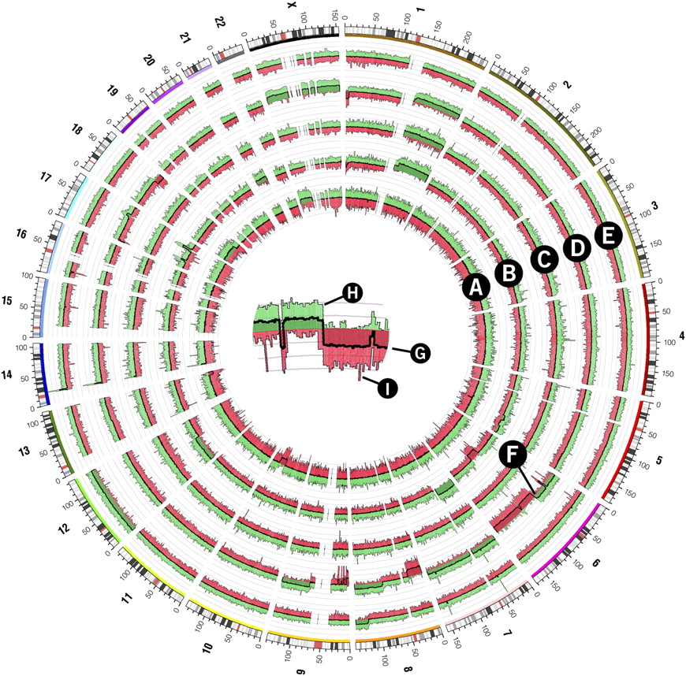

Copy number whole-genome profiles of five follicular lymphoma tumor samples generated from the Affymetrix Mapping 500K array.
Krzywinski M et al. Genome Res. 2009;19:1639-1645
Copyright © 2009 by Cold Spring Harbor Laboratory Press
Notes:
Copy number whole-genome profiles of five follicular lymphoma tumor samples generated from the Affymetrix Mapping 500K array. Samples are represented in each of the five histograms in tracks A–E. A crop of histogram region F is shown in the center of the figure to demonstrate the structure of each histogram track. The central thick line (G) represents the average probe value across 250 adjacent probes. The area between this line and y = 0 is filled with green or red depending on whether the average value is positive (i.e., increased copy number value) or negative (decreased copy number value), respectively. Variability within each 250-probe set is shown in histogram components H and I, which show the maximum and minimum of three-probe average values within the set, respectively. The area under the maximum and minimum traces is filled with a lighter green or red, respectively.

Slide 86

Circos in scientific publications
Developed at: Canada’s Michael Smith Genome Sciences Center
Under the license under GPL
522 as of October 2013
10 used in publication involving mitochondrial DNA projects

Slide 87
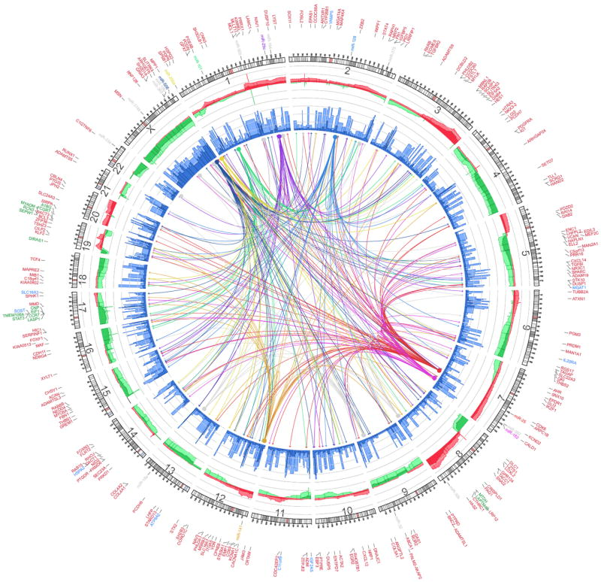
Yang, D. et al. Cancer Cell 2013; 23(2): 186 - 199 Integrated analyses identify a master microRNA regulatory network for the mesenchymal subtype in serous ovarian cancer
Notes:
Integrated Circos plot shows mesenchymal signature genes regulated by copy number (CN), methylation, and miRNA. An ideogram of a normal karyotype is shown in the outer ring. The next outermost ring represents copy number as a function of genomic coordinates. (Red represents amplification and green represents deletion. Dark red and dark green indicate median CN values across all patients, and lighter red and green indicate the 25th and 75th percentiles. The vertical axis ranges from -1 to +1 on a log₂ scale.) The next ring represents the amount of DNA methylation: dark blue indicates the median methylation beta value, and light blue indicates the 75th percentile. The vertical axis ranges from 0 to 1, and methylation data are averaged using variable-width bins along the genomic axis (25 CpG probes per bin). In the center of the figure, each arc indicates a predicted regulatory relationship between a miRNA (solid circle) and a gene (arrow). The colored arcs represent predicted regulation by the eight key miRNAs, whereas the grey arcs represent regulation by the remaining 11 miRNAs. Outside the ideogram, the miRNAs are colored the same as the corresponding arc. Outside the miRNA labels are the miRNA-associated genes (red), CNA-associated genes (green), and methylation-associated genes (blue).

Slide 88

Zeron-Medina, J; Wang, X. et al. Cell, 2013 v155(s): 410 – 422 A Polymorphic p53 Response Element in KIT Ligand Influences Cancer
Risk and Has Undergone Natural Selection
Notes:
A Circos plot displaying the cancer GWAS SNPs and their proxies screened for the presence of p53 occupancy, an above average p53-RE and location in a core nucleotide of the RE. Chromosomes are arranged in a half-circle end-to-end with chromosome’s cytobands in the outer ring. The location of the 892 cancer GWAS SNPs are displayed in the green inner ring and their 61,675 proxies are displayed in the blue ring. Grey lines identify those SNPs that are occupied by p53 in at least in one condition studied. Orange lines identify the two occupied polymorphic regions with above average p53-REs. The red line identifies the SNP that also resides in a core nucleotide of the RE.

Slide 89
Circos for Kleeberger’s lab
“First, and perhaps ironically, Circos does NOT actually understand the concept of a circular chromosome. In other words, a chromosome, which is represented by one or more ideograms, must have a beginning and an end which are explicitly defined”
An example provided by the developer was really a microbial genome, and it can get very much complicated
Currently running off a virtual machine
Testing the circular genome (a microbial genome example)
Mus musculus mitochondrion sequence: http://www.ncbi.nlm.nih.gov/nuccore/167716836?report=genbank
Need to finalize on the data to show for the publication

Slide 90

Kabekkodu, S. et al. Mitochondrion 2014; 16: 73 - 82 Mitochondrial DNA variation analysis in cervical cancer
Notes:
Distribution of nucleotide variations across the whole mitochondria. We have used Circos tool to plot the mtDNA variation (http://circos.ca/). The blue, red and green color represents variation present in non-malignant, malignant and common between non-malignant and malignant respectively. The color coded highlights of purple, blue, yellow, dark red and green within circle represents D-loop, 12s RNA, 16s RNA, tRNA and Coding region respectively.

Slide 91


Deletion breakpoints are not randomly distributed throughout the mitochondrial genome.
Damas J et al. Nucl. Acids Res. 2012;40:7606-7621
© The Author(s) 2012. Published by Oxford University Press.
Notes:
Deletion breakpoints are not randomly distributed throughout the mitochondrial genome. (A) A circular representation of the human mtDNA with annotated tRNA (black), rRNA (brown) and protein-coding (green) genes (outer track). The central track depicts the location of 5′- (blue) and 3′- (red) breakpoints. The central lines indicate the deleted region in the 753 reported cases. (B) The distribution of 5′- (blue bars) and 3′- (red bars) deletion breakpoints in the human mtDNA. The locations of the mitochondrial genes are shown below the x-axis.

Slide 92

Wang, Y. et al. PLoS One 2013; 8(8) Genome-wide analysis reveals coating of the mitochondrial genome by TFAM
Notes:
Circos plot of plus strand and minus strand TFAM ChIP-seq and input read density signal over chrM. (A, E) Annotation of protein coding (green on forward/heavy strand, red on reverse/light strand), ribosomal RNA (blue) and tRNA (blue on forward/heavy strand, grey on reverse/light strand) transcripts. (B) D-loop (black), LSP promoter (large red tile), known LSP TFAM binding site (small red tile), HSP promoter (large blue tile), known HSP1 TFAM binding site (small blue tile), and origins of heavy strand replication (Ori-b, orange tile; O_{H}, yellow tile). (C) TFAM ChIP-seq signal on forward (red) and reverse (blue) strands. (D) Input signal on forward (red) and reverse (blue) strands. (F) Origin of light strand replication (yellow tile). Note that the input signal is exaggerated 60-fold relative to the ChIP-seq signal in order to visualize coverage irregularities. The signal from the TFAM ChIP-seq largely follows that of the input, indicating generalized binding across the mitochondrial genome.

Slide 93

Fang, Y. et al. PLoS One 2012; 7(5) A complete sequence and transcriptomic analyses of date palm (Phoenix dactylifera L.) mitochondrial genome
Notes:
We display (starting from outside to inside): physical map scaled in kb, coding sequences transcribed in the clockwise (red) and counterclockwise directions (blue), chloroplast-derived regions (green boxes), sequence repeats (black), histogram of transcriptome data (green bar, standing for average RPKM value per 200 bp, transformed using natural logs and ranging from 0 to 10), GC content variations (brown bar in a 500 bp sliding window and 500 bp increments), and SOLiD mate-pair (MP) read validation (sliding window 2 kb, MP insertion size 5–6 kb, Step size 15 kb). This figure was generated by using the Circos program [68]. Ψ indicates pseudogene.

Slide 94

Ravin, N. et al. Current Genetics 2010; Feb. Complete sequence of the mitochondrial genome of a diatom alga Synedra acus and comparative analysis of diatom mitochondrial genomes
Notes:
Gene map of the S. acus mtDNA. Genes and ORFs are shown as solid blocks. The gene blocks shown outside and inside the circular map are transcribed in the clockwise and counter-clockwise directions, respectively. The color of the box designates the type of gene: the protein-coding genes are grey, the rRNA genes are light grey, the tRNA genes are black. The pseudogenes are marked by . For intron-containing genes, the “-eN” suffix denotes the exon number. The exon–exon junctions are shown as black lines connecting the exon ends. The large repeat region is shown as the grey-hatched block.

Slide 95


